Slide 1
ONLINE BOOKSTORE MANAGEMENT

Slide 2
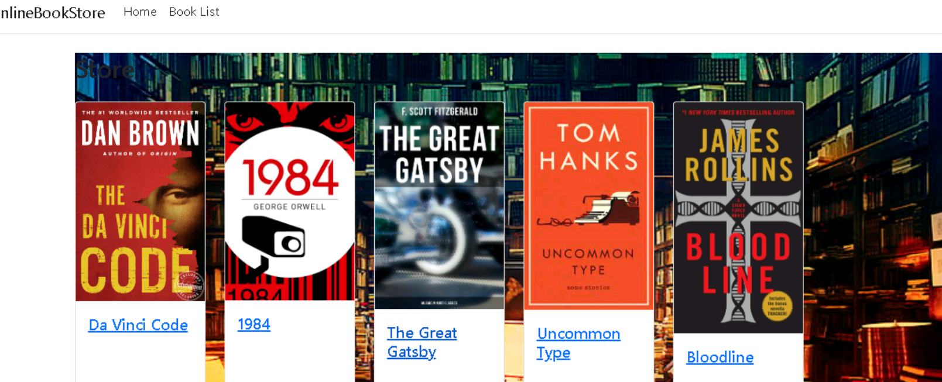
HOME PAGE
A Home Page which shows Store that contains Books

Slide 3

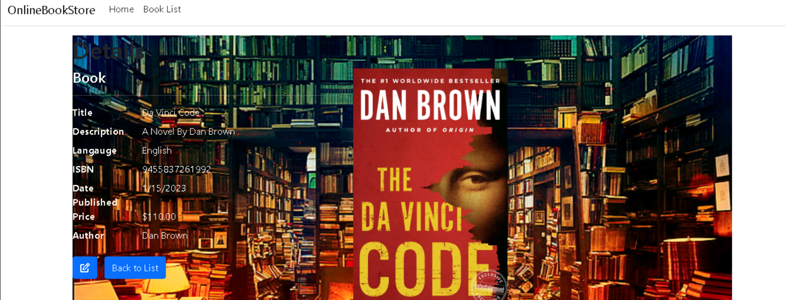
Book Details
This page shows the specific Book Details.

Slide 4
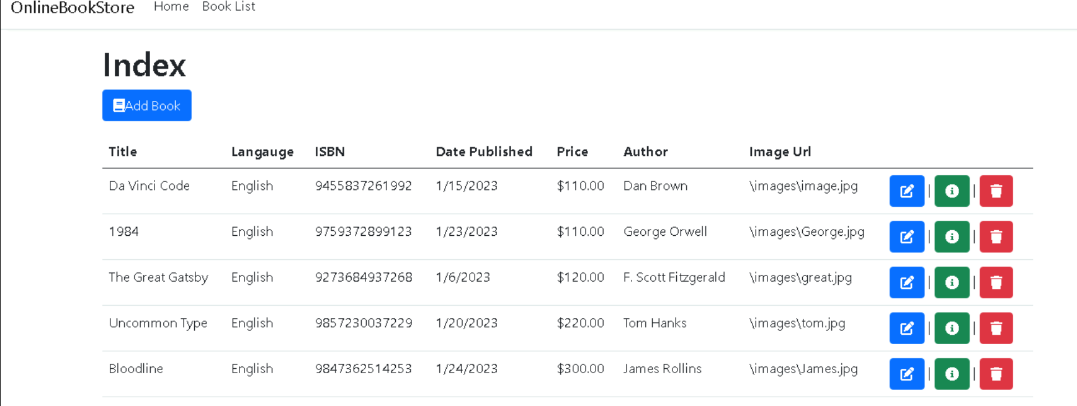
Book List This Page shows the list of books.

Slide 5
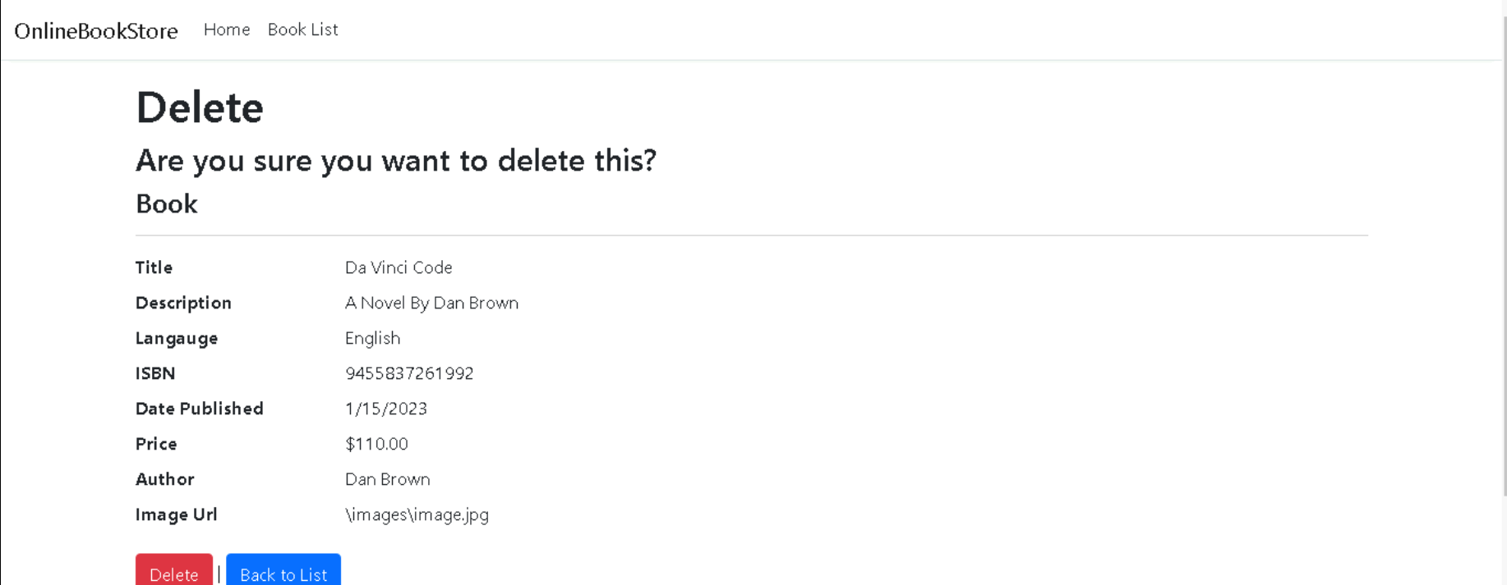
Delete Page We Can delete Specific book.

